Slide 1
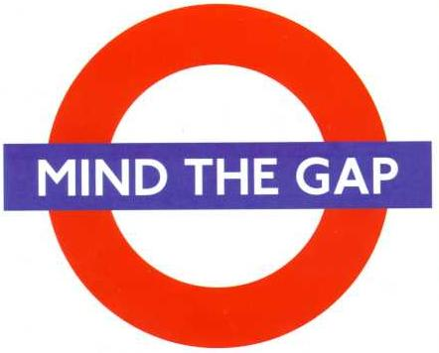
The Great Vocabulary Gap:
What gets taught vs.
What learners’ really need
Norbert Schmitt

Slide 2
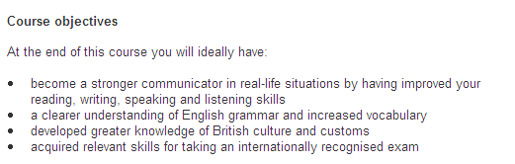
Vocabulary in the Syllabus

Slide 3
Vocabulary in the Syllabus

Slide 4
Three fundamentals
Breadth / Size
Depth
Engagement

Slide 5
Breadth (or Vocabulary Size)
How much vocabulary do learners need to know?

Slide 6
High / Mid / Low frequency Vocabulary
3,000 3,000 – 9,000 9,000+
Hi-frequency Mid-frequency Low-frequency
vocabulary vocabulary vocabulary

Slide 7
How much vocabulary do learners need?
It depends on what they want to do…
250 words or fewer – read graded readers
2-3,000 words - understand defining vocabulary of learner dictionaries
2-3,000 words – participate in daily conversation
3,000 – use TV and movies for teaching/learning
5,000 words – read authentic texts w/assistance
6-7,000 words – understand a wide range of oral discourse without assistance
8-9,000 words – understand a wide range of written discourse

Slide 8
The ability to use English requires a large vocabulary
Written Discourse
8,000-9,000 word families (98% coverage:
Hu and Nation 2000; Nation, 2006)
Spoken Discourse
6,000-7,000 (98%: Nation, 2006)
Notes:
8

Slide 9
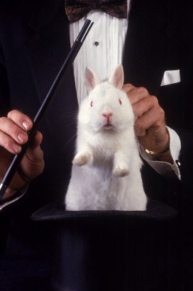
Where do these numbers come from anyway?

Slide 10
Vocabulary size requirement estimates
Where do these figures come from?
Studies combining:
Vocabulary coverage:
The percentage of words known in a text
Reading comprehension:
The percentage of information which can be
taken from a text

Slide 11
Fat City (95% coverage)
In December, to the delight of many __________ and the ______ of many doughnut lovers, the New York City Board of Health voted to ban artificial trans fats from restaurants, school cafeterias, pushcarts, and almost every other food-service establishment it oversees, which includes most everything except hospitals. Trans fats don’t occur naturally in the things people like but feel guilty eating, or at least not at high levels (there are small proportions in the fat in meat and dairy products). But artificial ones are plentiful in commercial foods, because they are easy to use, cheaper than natural fats, and keep practically forever. Trans fats are made by pumping _______ gas into liquid fats usually in the presence of _____ so that they will remain solid at room temperature, like butter and ___; and they have the same wonderful properties in pie crusts, cookies, and cakes. Crisco, still _____ for solid shortening made by partial ___________ (of cottonseed oil), soon became the “______” choice for pie crust and fried chicken, making pastry almost as flaky and skin almost as crisp as ___ does.

Slide 12
Fat City (95% coverage)
In December, to the delight of many cardiologists and the dismay of many doughnut lovers, the New York City Board of Health voted to ban artificial trans fats from restaurants, school cafeterias, pushcarts, and almost every other food-service establishment it oversees, which includes most everything except hospitals. Trans fats don’t occur naturally in the things people like but feel guilty eating, or at least not at high levels (there are small proportions in the fat in meat and dairy products). But artificial ones are plentiful in commercial foods, because they are easy to use, cheaper than natural fats, and keep practically forever. Trans fats are made by pumping hydrogen gas into liquid fats usually in the presence of nickel so that they will remain solid at room temperature, like butter and lard; and they have the same wonderful properties in pie crusts, cookies, and cakes. Crisco, still generic for solid shortening made by partial hydrogenation (of cottonseed oil), soon became the “sanitary” choice for pie crust and fried chicken, making pastry almost as flaky and skin almost as crisp as lard does.

Slide 13
The Truth About Beauty (98% coverage)
Cosmetics makers have always sold “hope in a jar” – creams and ______ that promise youth, beauty, sex appeal, and even love for the women who use them. Over the last few years, the marketers at Dove have added some new-and-improved __________. They’re now promising self-esteem and cultural transformation. Dove’s “Campaign for Real Beauty,” declares a press release, is “a global effort that is intended to serve as a starting point for societal change and act as a ______ for widening the definition and discussion of beauty.” Along with its thigh-firming creams, self-tanners, and hair conditioners, Dove is peddling the crowd-pleasing notions that beauty is a media creation, that recognizing plural forms of beauty is the same as declaring every woman beautiful, and that self-esteem means ignoring imperfections.

Slide 14
The Truth About Beauty (98% coverage)
Cosmetics makers have always sold “hope in a jar” – creams and potions that promise youth, beauty, sex appeal, and even love for the women who use them. Over the last few years, the marketers at Dove have added some new-and-improved enticements. They’re now promising self-esteem and cultural transformation. Dove’s “Campaign for Real Beauty,” declares a press release, is “a global effort that is intended to serve as a starting point for societal change and act as a catalyst for widening the definition and discussion of beauty.” Along with its thigh-firming creams, self-tanners, and hair conditioners, Dove is peddling the crowd-pleasing notions that beauty is a media creation, that recognizing plural forms of beauty is the same as declaring every woman beautiful, and that self-esteem means ignoring imperfections.

Slide 15
Vocabulary Coverage / Reading Comprehension
Notes:
15

Slide 16
Vocabulary Coverage / Reading Comprehension
Notes:
16

Slide 17
Vocabulary Coverage / Reading Comprehension
Notes:
17

Slide 18
Vocabulary Coverage / Reading Comprehension Schmitt, Jiang & Grabe (2011)
Notes:
18

Slide 19
Vocabulary Coverage in a Children’s Movie
95%
98%

Slide 21
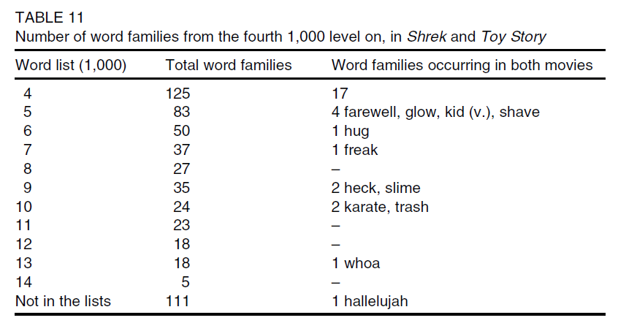
Comparison of Two Children’s Movies

Slide 22
A lexical syllabus?
Language Leader
Elementary
  461 word families
Pre-intermediate
  297 word families
Success
  718 word families
  350 word families
Overlap
70 families
Overlap 234 families
Overlap 77 families

Slide 23
Language Leader Elementary
New Total English Elementary

Slide 25
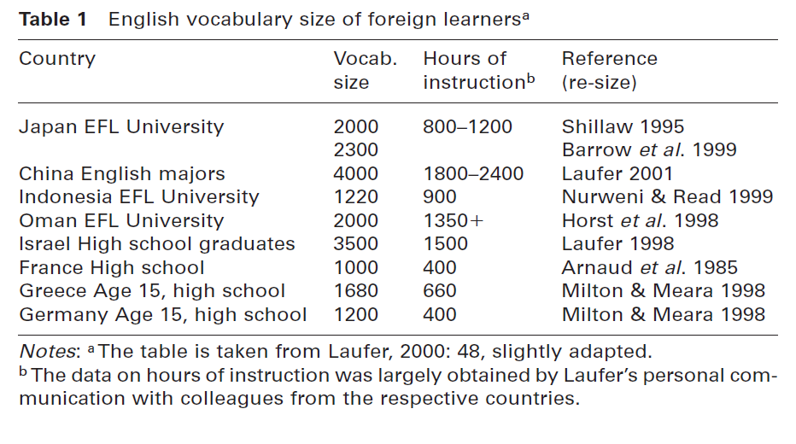
Vocabulary Size of Learners

Slide 26
The great vocabulary size gap
Learners know: 2,000-5,000 families
Learners need:
6,000-7,000 word families (spoken)
8,000-9,000 word families (written)
1,000-7,000 word family shortage
Notes:
26

Slide 27
Vocabulary in the Current Curriculum
Curriculum Guidance:
Vocabulary items are divided into
core items, listed specifically in this vocabulary list, and
expansion, chosen by the materials writers and/or teachers.

Slide 28
Ministry of Education Vocabulary Goals (draft)
More words in the core to ensure that all words get attention in textbooks and classroom teaching.
Target | Pre-Basic | Foundation Band 1 |  | Intermediate Band 2 |  | Proficiency Band 3
Core | 165 | 507 | 569 | 862 | 876 | 2070
Expansion |  | 100 |  | 264
Total of each level |  | 1200 |  | 1800 |  | 2200
Total | 5400 (5 pointers) = B1+

Slide 29
+9%
+7
+3%
+12
Receptive Vocabulary
Optimal Threshold – 98% (8000 word families)
Minimal Threshold – 95% (4-5,000 word families)
Max Score 150
Even small increases in vocabulary coverage can lead to big gains in comprehension.
Laufer and Ravenhorst-Kalovski, 2010
Reading in a Foreign Language
Reading Score
134 – Exempt from English
116 – 1 semester
104 – 2 semesters
95 – 3 semesters

Slide 30
Pedagogy: A Start
Lots of exposure to English texts will take care of learner’s vocabulary needs.
Right?

Slide 31
A vocabulary analysis of a textbook
Matsuoka & Hirsh (2010)
New Headway Upper Intermediate
44,877 running words – 12 chapters
high frequency vocabulary provided 95.5% coverage
(GSL + AWL + proper nouns + 32 other word families)
1,005 remaining word families
66.4% occurred only once/only 12.1% occurred five times or more.
Other levels?
New Headway Intermediate wordlist
451 word families
340 high/110 mid-frequency families
New Headway Advanced wordlist
782 families
263 high/427 mid-frequency families.
The authors of the series state that the books contain a ‘very strong lexical syllabus’ (Soars & Soars 1996: v)

Slide 32
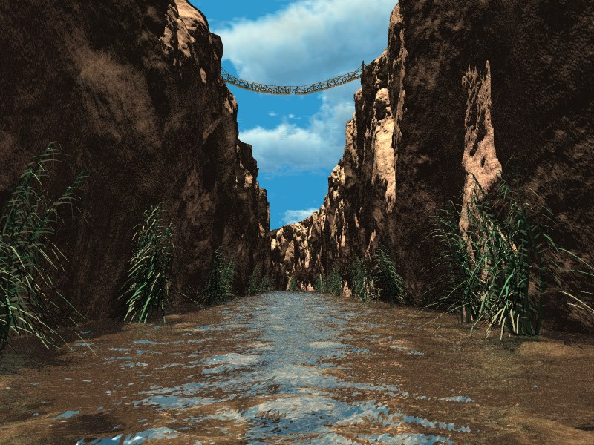
The Great Vocabulary Gap -Depth

Slide 33
What does it mean to know a word?
word
meaning

Slide 34
There is More to Knowledge than
Just Meaning and Form
meaning
spelling
pronunciation
associations
grammar
word
collocations
frequency
formality
connotation

Slide 35
More to Word Knowledge than Just Meaning
word
meaning
pronunciation
grammar
frequency
connotation
formality
collocations
associations
spelling

Slide 36
Various kinds of word knowledge are needed
Learning a word requires more than just learning just its meaning and form
Learners must learn all of the ‘contextual’ kinds of word knowledge as well
These are more difficult to teach, and require large amounts of exposure
Acquiring depth of knowledge is just as important as increasing vocabulary size

Slide 37
Vocabulary learning is incremental
Learners need multiple contacts with words to learn them
5-16 or more exposures
Depends on type of exposure and level of engagement
Incidental learning
- L1 reading studies: chances of learning from
a single exposure: 1/7 – 1/20
- L2 reading studies: learning does occur,
but is generally not robust

Slide 38
Form: regularity/lack of systematicity
Book, write, read, desk, letter, secretary, scribe
  All refer to writing – semantic relationship
  No similarity in form
In Arabic, words that are semantically related are represented by the three shared consonants.
  k-t-b
  Different meanings are signalled systematically

Slide 39
Form: sound/symbol correspondence
  a. though b. thought c. tough
  d. dough e. cough f. rough
  a. character b. machine c. chair
  d. coach e. headache f. moustache

Slide 40
Form: synforms
Learners often confuse similar word forms
  outline = out of line
  discourse = without direction
Category of greatest confusion:
  similar except for suffixes
(comprehensive / comprehensible)
  similar except for vowels
(adopt / adapt)
(Laufer, 1988)

Slide 41
A Word’s Form May Be More
Difficult Than Its Meaning
The flag is the nation symbol.
I get a lot of enjoy from listening
to music.
When she heard the good news, she smiled happy.

Slide 42
A Word’s Form May Be More
Difficult Than Its Meaning
The flag is the national symbol.
I get a lot of enjoyment from listening to music.
When she heard the good news, she smiled happily.

Slide 43
Schmitt & Zimmerman (2002)
persist
Noun The judge changed his mind because
of the lawyer’s ________.
Verb The lawyer ________ until the judge
changed his mind.
Adjective The ________ lawyer persuaded the
judge to change his mind.
Adverb The lawyer argued ________.

Slide 44
Schmitt & Zimmerman (2002)
persist
Noun The judge changed his mind because
of the lawyer’s persistence.
Verb The lawyer persisted until the judge
changed his mind.
Adjective The persistent lawyer persuaded the
judge to change his mind.
Adverb The lawyer argued persistently.

Slide 45

Schmitt & Zimmerman (2002)
Nottingham and California university students
Advanced learners typically knew some, but not all derivative forms (2 or 3 out of 4)
Typically knew noun and verb forms better than adjective and adverb forms

Slide 46
Pedagogy: textbooks
Dale Brown – How do textbooks approach the teaching of word knowledge?

Slide 47
Brown’s Textbooks

Slide 48
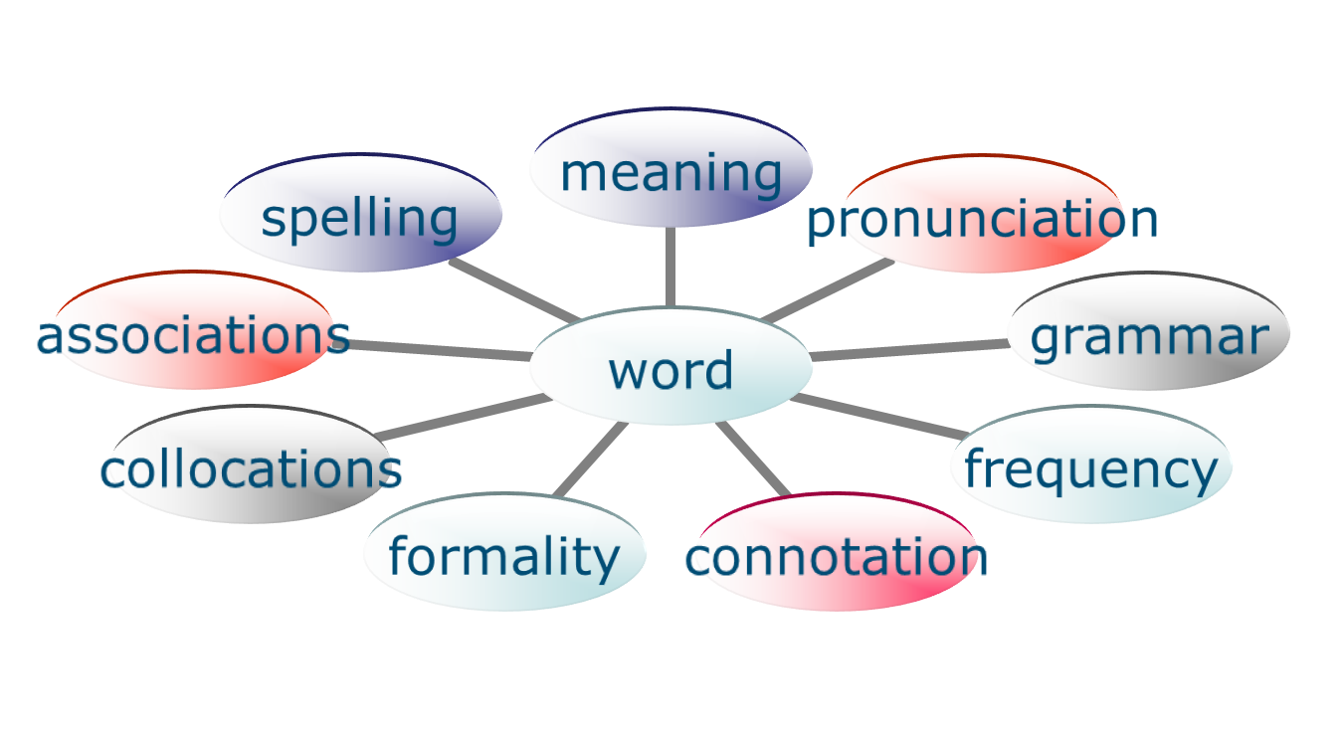
Nation’s Word Knowledge Framework

Slide 49
Brown’s Results

Slide 50
Pedagogy: teachers
Horst, Collins and Cardoso (2009) investigated vocabulary focus in teacher talk

Slide 51
Context and Corpus
Horst, Collins and Cardoso (2009)
Intensive primary ESL (grade 6) in Quebec
  Shared L1 is French
  CLT classrooms with topics like hobbies, food, clothes
3 experienced, trained ESL teachers
  Each filmed 4 times
  12 full days (~ 4 hours of instruction each)
Total = ~ 50 hours of recordings
118,000 words of transcribed teacher talk
  Collected for an input study (Collins, Trofimovich, White, Cardoso, & Horst, 2009)
Notes:
51

Slide 52
How much focus on language form?
12 – 128 vocabulary interventions per 4.5-hour day
Notes:
52

Slide 53
What kinds of vocabulary?
Single words vs. multi-word items (tokens)
 | Words | MWIs
Teacher 1 | 75% | 25%
Teacher 2 | 75% | 25%
Teacher 3 | 78% | 22%
Notes:
53

Slide 54
Examples of multi-word items
2-word
  baking soda
  sore throat
  spit out
  taste buds
  used to
  flannel shirt
  garage sale
3-word
  have an accident
  heart-shaped face
  v-neck sweater
  daddy long legs
  sister-in-law
  shoot the puck
  pass the puck
Notes:
54

Slide 55
High frequency or low frequency?
Frequency distributions (tokens, in %)
 | 1K | 2K | 3K | 4K | 5K | 6K | 7K | 8-20K
T1 | 33 | 18 | 14 | 4 | 5 | 2 | 5 | 20
T2 | 45 | 17 | 8 | 4 | 0 | 3 | 2 | 13
T3 | 33 | 16 | 17 | 8 | 6 | 4 | 3 | 11
    Target learning zone for these learners
    2K – 4K?
Notes:
55

Slide 56
Sample 3K items Sample 8k+ items
bench
gloves
scream
melt
angry
lawn
sleeve
bitter
colander
evanescence
broil
corduroy
birthmark
camisole
blizzard
premonition
Notes:
56

Slide 57
To what extent does vocabulary teaching address form, meaning, use
Form - spoken (pronunciation) | 92
Form - written (spelling) | 21
Form - morphology | 84
Meaning | 564
Use – collocation* | 25
*references to other aspects of use, e.g. frequency, were not found
Notes:
57

Slide 58
Example – translation
S: When you slide, when you slide you go very uh... How you say loin?
Ss (in chorus): Far.
T: Far.
58
Notes:
58

Slide 59
Example – realia
T: You know this word? (Teacher writes on the blackboard)
Ss: Scar.
T: Where, where does Harry Potter have a scar?
Ss: Here! Fore… (in unison)
T: Right. Okay. He has-- Okay. Please. (Student Name), turn around ... Yes, so he has a scar. Do you have scars?
S1: Uh, yes uh,…
T: Behind your ears?
Notes:
59

Slide 60
Examples – short definitions
Synonyms / Context
  T: When you have water on the ground, a little bit of water, we call that a puddle … a puddle of water …. In the spring we have puddles of water too.
Antonyms/ Contrastive
  S: The knob
  T: Not the knob. How do you call it what you hold the pail by?....the handle
60
Notes:
60

Slide 61
Findings – explaining meaning
61
Notes:
61

Slide 62
Use a learner’s dictionary to assist in planning what to teach about words
Learner’s dictionaries provide:
  Definitions in accessible language
  Information about grammatical features or constraints
  Guidance about collocations, formality, frequency and other types of word knowledge
LASD and LDOC
  Collocation boxes
  Thesaurus boxes
  Word choice boxes
  Common Phrases

Slide 63
The Great Vocabulary Gap - Engagement

Slide 64
Factors that facilitate vocabulary learning
Increased frequency of exposure
Increased attention focused on the lexical item
Increased noticing of the lexical item
A requirement to learn the lexical item (by teacher, test, syllabus)
A need to learn/use the lexical item (for a task or for a personal goal)
Increased manipulation of the lexical item and its properties
Increased amount of time spent engaging with the lexical item
Amount of interaction spent on lexical item

Slide 65
Pedagogy: teachers
Horst, Collins and Cardoso (2009) investigated vocabulary focus in teacher talk

Slide 66
Findings – review
66
To what extent do the same words receive focus again?
  Of 496 types
    68 were reviewed 2X – 14%
    23 were reviewed 3X – 5%
    4 were reviewed 4x – 1%
    1 was reviewed 5x (fry + frying pan)
    All on the same day
Notes:
66

Slide 67
Findings – learning potential
To what extent are there opportunities to
  Process?
    293 of 551 cases – 53%
  Use?
    193 of 551 cases – 35%
67
Notes:
67

Slide 68
SUMMARY

Slide 69
Principles for vocabulary teaching and learning (Schmitt, 2008)
Set high vocabulary targets and pursue them
Be prepared to use different approaches at different points in the incremental learning process
Start by establishing a strong meaning-form link and consolidate this with repeated exposure – using the L1 is a sensible place to start
Enhance knowledge of different aspects of word knowledge – both explicitly and implicitly through exposure
Ensure that learners maintain the maximum amount of engagement with lexical items

Slide 70
Curriculum Revision Considerations
Set Vocabulary Targets
Provide guidance to textbook writers
Provide in-service teacher training
Provide guidance to teacher colleges
Assess vocabulary learning
Evaluate innovation
Review targets
Provide guidance to exam writers

Slide 71


☞
www.norbertschmitt.co.uk
71

Slide 72
References
Brown, D. (in press). What aspects of vocabulary knowledge do textbooks give attention to? Language Teaching Research.
Horst, M. Collins, L. and Cardoso, W. (2009). Focus vocabulary in ESL teacher talk. Paper presented at the American Association of Applied Linguistics Conference in Denver.
Hu, M., & Nation, I.S.P. (2000). Vocabulary density and reading comprehension. Reading in a Foreign Language, 13(1), 403–430.
Nation, I.S.P. (2006). How large a vocabulary is needed for reading and listening. The Canadian Modern Language Review, 63 (1), 59-82.
Schmitt, N. (2008) Review Article: Instructed second language vocabulary learning, Language Teaching Research 12, 329-363.
Schmitt, N., Jiang, X., and Grabe, W. (in press). The relationship between the amount of vocabulary known in a text and reading comprehension. Modern Language Journal.
Walters, J. and Bozkurt, N. (2009). The effect of keeping vocabulary notebooks on vocabulary acquisition. Language Teaching Research, 13(4), 403-423.
Zahar, R., Cobb, T., & Spada, N. (2001). Acquiring vocabulary through reading: Effects of frequency and contextual richness. The Canadian Modern Language Review, 57(3), 541–572.

