Slide 1
Maskit Model

Slide 2
Let’s talk about individual hours (Partani)…
What do think about individual hours?
Do you think the individual work benefits our kids?
How do you teach during individual hours?
How is the individual work different than your regular lesson?

Slide 3
Partani teaching should be based on the following premises:
Tutoring a small group is just as intricate as teaching a full class.
Student must be invested & involved.
Through yet flexible planning.
Enables the use and development of a personal connection for pedagogical purposes.

Slide 4
Goal
Define the lesson goals and the required actions in a clear and precise manner
Discussion
Pre-discussion dialog between the student and the teacher regarding the lesson’s goals
Strengths
Identify the strengths in the student’s abilities required to achieve the goals
Implementation
Present the planned actions and the rationale to the student and implement.
Finalization, Assessment & Future Planning
Assess and receive feedback
Identify future actions necessary

Slide 5
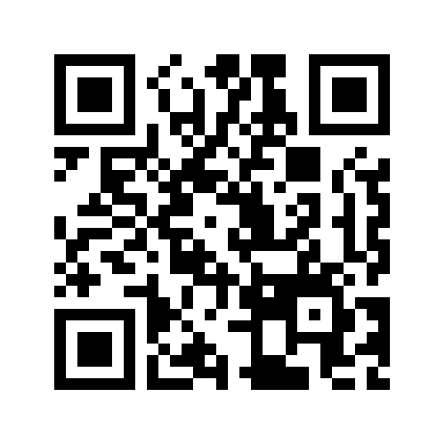
Group Work - Instructions:
A group of students with:
Difficulties understanding information from written text.
Difficulties sequencing events in a written text.
Limited vocabulary.
Lesson objective: Recognizing key-words.
Each group will work on a different Maskit stage.
Post your work on Padlet CODE#

Slide 6
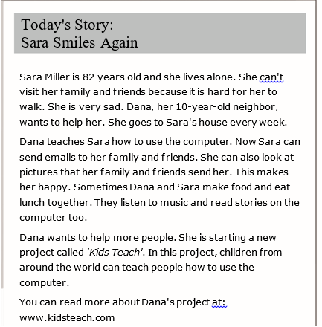
The text:

Slide 7
