Slide 1

VOCABULARY

Slide 2

Opening
From theory to practical
Experience in vocabulary
The three R’s
Practice ideas
Game
BREAK….
Group work
Sum up…

Slide 3
Why do we even need vocabulary?

Slide 4
How Many Words are Enough?
Let’s try something for a minute

Slide 5
Obama’s State of the Union Speech, 2010
You have 85% of the words, can you fill-in the blanks?
That is the work we began last year. Since the day I took office, we renewed our focus on the __________ who __________ our nation. We have made substantial __________ in our homeland __________ and disrupted _________ that threatened to take American ____________.

Slide 6
85% of the words, not only do not ensure understanding the main ideas. They also do not provide sufficient evidence to help guess/understand the unknown words.

Slide 7
Obama’s State of the Union Speech, 2010
With 95% of the words, can you guess what is missing?
That is the work we began last year. Since the day I took office, we renewed our focus on the _________ who threaten our nation. We have made substantial __________ in our homeland security and disrupted plots that threatened to take American lives.

Slide 8
Obama’s State of the Union Speech, 2010 - full text:
That is the work we began last year. Since the day I took office, we renewed our focus on the terrorists who threaten our nation. We have made substantial investments in our homeland security and disrupted plots that threatened to take American lives.

Slide 9

Did You Know…?
Researchers estimate you need to know 95%-98% of the words in a text in order to fully understand it.
You need to know about 8,000 words in order to be able to understand an un-simplified written text in English.
The ministry site

Slide 10


REVIEW
REPEAT
RECYCLE

Slide 11
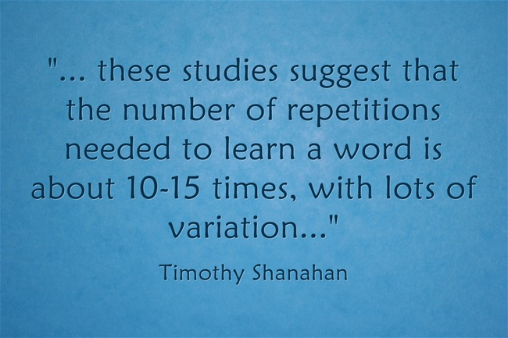
In an article on VOA news, Catherine Snow of Harvard's Graduate School of Education gives us some numbers on how many exposures you need to a word before you learn it: you need to encounter it fifteen, twenty times.
HOW DO WE REPEAT A WORD SO MANY TIMES IN CLASS?

Slide 12

AT LEAST 15

Slide 13
  Tic-tac-toe
  Hot-cold
  Bingo
  What is missing?
  Choral reading
  Memory game
  Word search
  Kahoot
  Quizlet
  wordsearch generator
  Uri Alon's site
  Wordle
  Domino generator

Slide 14



Slide 15
WELCOME BACK….
LETS LAUGHT A LITTLE

Slide 16
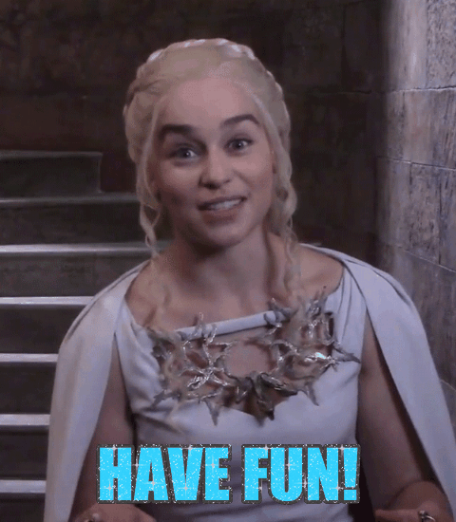
Group work:
Group 1- Fry’s sight words 1-25
Group 2- Fry’s sight words 26-50
Group 3- Categories
Group 4- past tense flash cards
Group 5- English Idioms flashcards
Group 6- Sight words domino

Slide 17

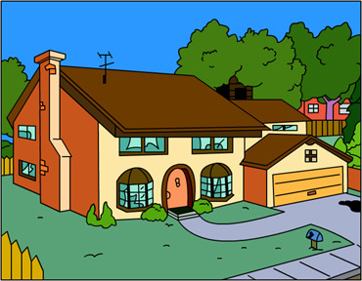
What did we learn today?

Slide 18


