Slide 1
Pre reading activity.
1. What do we learn from the title?
Around the World Magazine
Brain storming

Slide 2
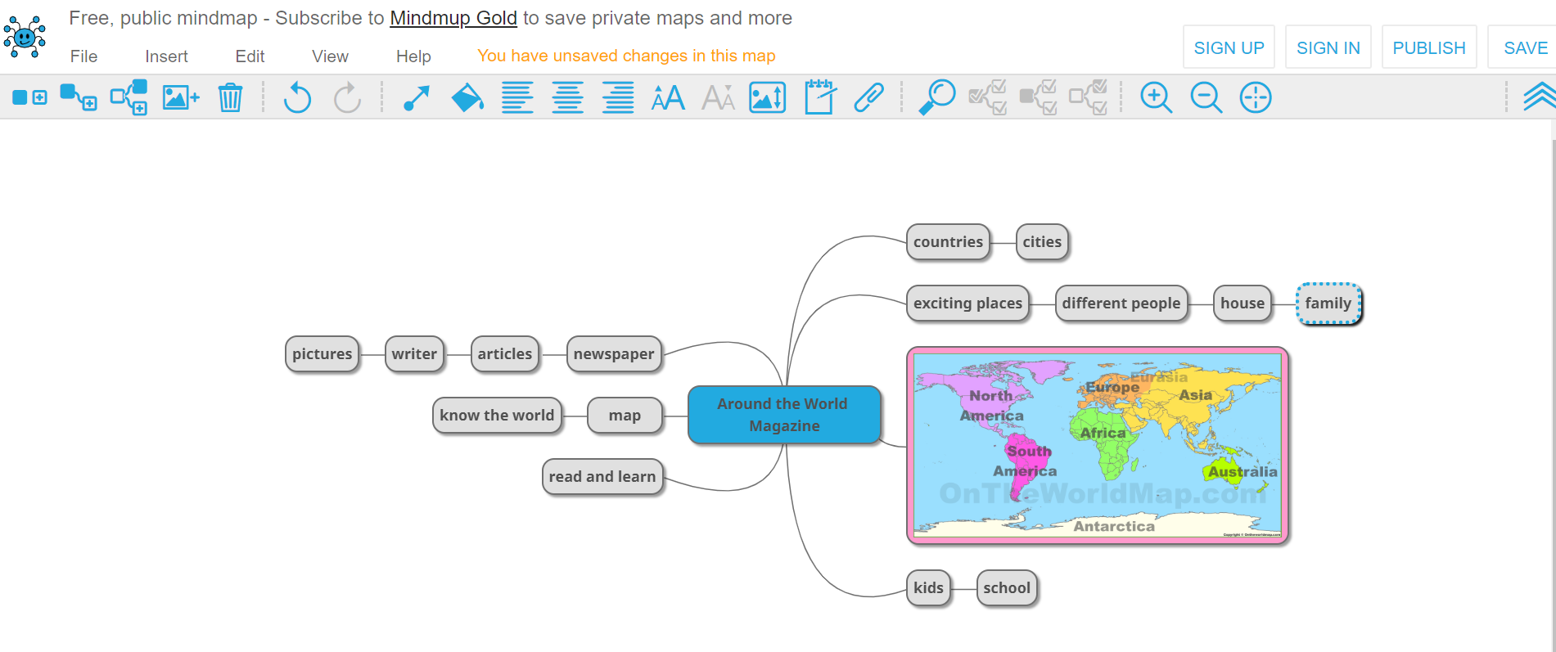

Slide 3

Pre reading activity.
2. Scanning the text.
Around the World Magazine March, 2018
Hi, my name is Gita. I'm eleven years old. I don't live in a city
or a village like many other children. I live on a boat in the sea near India.
I don't walk or ride a bike to school because my school is on
a boat too. My friends and I swim to school every morning. At school we build boats together with our teacher. We also learn how to catch fish.
Every afternoon I help my parents catch fish. I'm a very good swimmer and can swim under water for a long time. Sometimes
I swim in very deep* water to catch big fish.
Tomorrow I'm going with my family to the city for the first time.
I want to help my parents sell fish in the market. I'm excited to see the houses and shops there.
I hope we sell all the fish we have!
© כל הזכויות שמורות לראמ"ה – הרשות הארצית למדידה והערכה בחינוך, משרד החינוך

Slide 4
Pre reading activity.
3. Highlight places, names and numbers.
Hi, my name is Gita. I'm eleven years old. I don't live in a city
or a village like many other children. I live on a boat in the sea near India.
I don't walk or ride a bike to school because my school is on
a boat too. My friends and I swim to school every morning. At school we build boats together with our teacher. We also learn how to catch fish.
Every afternoon I help my parents catch fish. I'm a very good swimmer and can swim under water for a long time. Sometimes
I swim in very deep* water to catch big fish.
Tomorrow I'm going with my family to the city for the first time.
I want to help my parents sell fish in the market. I'm excited to see the houses and shops there.
I hope we sell all the fish we have!

Slide 5
Pre reading activity.
4. Read the first line in every paragraph.
Hi, my name is Gita. I'm eleven years old. I don't live in a city
or a village like many other children. I live on a boat in the sea near India.
I don't walk or ride a bike to school because my school is on
a boat too. My friends and I swim to school every morning. At school we build boats together with our teacher. We also learn how to catch fish.
Every afternoon I help my parents catch fish. I'm a very good swimmer and can swim under water for a long time. Sometimes
I swim in very deep* water to catch big fish.
Tomorrow I'm going with my family to the city for the first time.
I want to help my parents sell fish in the market. I'm excited to see the houses and shops there.
I hope we sell all the fish we have!

Slide 6
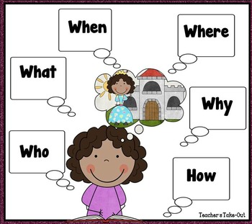
Pre reading activity.
5. Now we are ready for the questions.

Slide 7
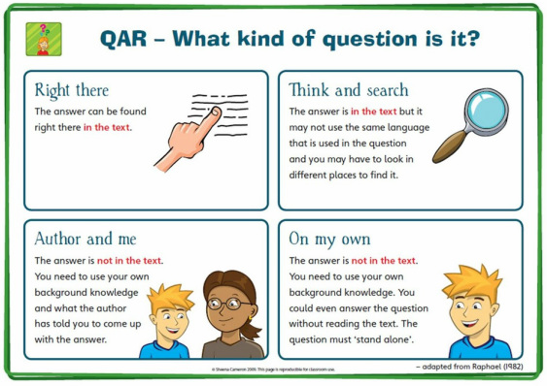

Slide 8
Questions
Right There Questions/ Literal: Literal questions whose answers can be found in the text. Often the words used in the question are the same words found in the text.
Think and Search Questions /Inferential: Answers are gathered from several parts of the text and put together to make meaning.
Author and You/ Interpretive: These questions are based on information provided in the text but the student is required to relate it to their own experience. Although the answer does not lie directly in the text, the student must have read it in order to answer the question.
On My Own/ Interpretive-Evaluative: These questions do not require the student to have read the passage but he/she must use their background or prior knowledge to answer the question.
http://mrslorber.weebly.com/qar-question---answer-relationship.html

Slide 9


REVIEW
REPEAT
RECYCLE

Slide 10
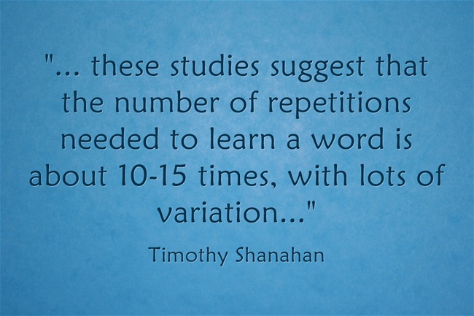
In an article on VOA news, Catherine Snow of Harvard's Graduate School of Education gives us some numbers on how many exposures you need to a word before you learn it: you need to encounter it fifteen, twenty times.
HOW DO WE REPEAT A WORD SO MANY TIMES IN CLASS?

Slide 11

AT LEAST 15 TIMES

Slide 12
  Tic-tac-toe
  Hot-cold
  Bingo
  What is missing?
  Choral reading
  Memory game
  Word search
  Kahoot
  Quizlet
  wordsearch generator
  Uri Alon's site
  Wordle
  Domino generator

Slide 13


